Slide 1
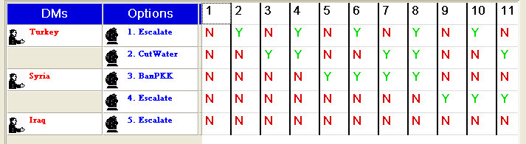
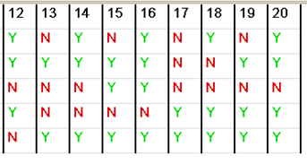
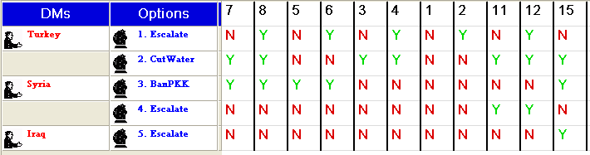
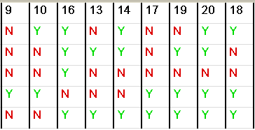
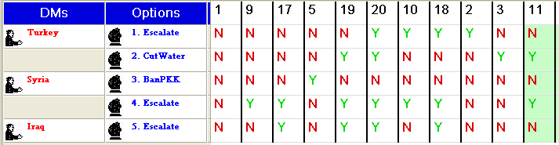
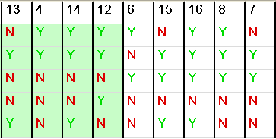
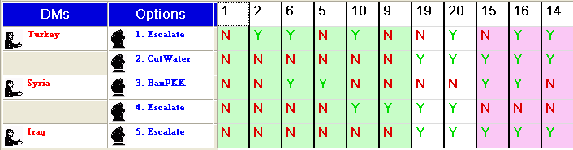
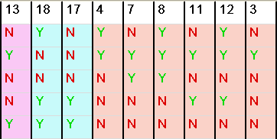
Turkey’s Preferences:
Syria’s Preferences:
Iraq’s Preferences:

Slide 2
T
S
I

Slide 3
1
4
Iraq
2
5
Syria
3
6

Slide 4
1
4
Iraq
2
5
Syria
Third Party
3
6
7
10
8
11
9
12

Slide 5
1
2
Turkey
3
4
Syria
9
Third Party
5
6
7
8

Slide 6
1
2
Turkey
3
4
Syria
7
5
6

Slide 7
1
2
5
6
Turkey
3
4
7
8
Improvement
Syria
9
10
Iraq
17
18
13
14
15
16
11
12
19
20

Slide 8
1
17
2
18
5
9
6
10
Syria
7
11
12
8
Iraq
3
4
Improvement by Syria
Improvement by Iraq
13
14
15
19
20
16

Slide 9
1
17
2
18
5
9
6
10
Syria
7
11
12
8
Iraq
3
4
13
14
15
19
20
16

Slide 10
1
17
2
18
Coalition Move
Syria & Iraq
5
9
6
10
Coalition Improvement
Syria & Iraq
3
4
7
19
8
20
11
15
12
16
13
14

Slide 11
1
17
2
18
Coalition Move
Syria & Iraq
5
9
6
10
Coalition Improvement
Syria & Iraq
3
4
7
19
8
20
#
Standard Equilibrium
#
Coalition Equilibrium
11
15
12
16
13
14

